Slide 1
功虧一簣 Going Down the Drain
啟示錄 Revelation 2:18-29

Slide 2
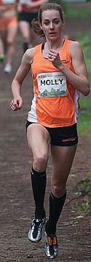
Molly Huddle
Notes:
https://en.wikipedia.org/wiki/Molly_Huddle

Slide 3
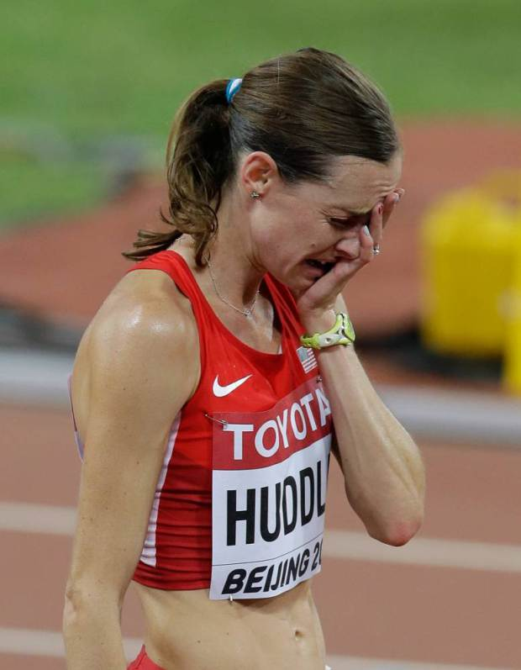
Notes:
http://metro.co.uk/2015/08/24/athlete-molly-huddle-celebrates-too-early-in-10000m-misses-out-on-world-championships-bronze-medal-5358528/
http://www.cbsnews.com/news/molly-huddle-american-runner-celebrates-early-loses-world-championship-medal/

Slide 4
Hebrews 12:1
¹ … 存心忍耐，奔那擺在我們前頭的路程
¹ … And let us run with perseverance the race marked out for us

Slide 5
1. 不要自滿 Don’t Get Complacent (18-19)
以弗所 Ephesus
士每拿 Smyrna
別迦摩 Pergamum
推雅推喇 Thyatira
撒狄 Sardis
非拉鐵非 Philadelphia
老底嘉 Laodicea

Slide 6
1. 不要自滿 Don’t Get Complacent (18-19)
Revelation 2:19
¹⁹ 我知道你的行為、愛心、信心、勤勞、忍耐，又知道你末後所行的善事，比起初所行的更多。
¹⁹ I know your deeds, your love and faith, your service and perseverance, and that you are now doing more than you did at first.

Slide 8
Revelation 2:18
¹⁸ “… the Son of God, whose eyes are like blazing fire and whose feet are like burnished bronze.
Revelation 2:23
²³ … I am he who searches hearts and minds, and I will repay each of you according to your deeds.
Revelation 2:18
¹⁸ 「… 『那眼目如火焰、腳像光明銅的上帝之子
Revelation 2:23
²³ … 我是那察看人肺腑心腸的，並要照你們的行為報應你們各人。

Slide 9
Jeremiah 17:9–10
⁹ 人心比萬物都詭詐， 壞到極處， 誰能識透呢？ ¹⁰ 我－耶和華是鑒察人心、試驗人肺腑的， 要照各人所行的和他做事的結果報應他。
⁹ The heart is deceitful above all things and beyond cure. Who can understand it? ¹⁰ “I the Lord search the heart and examine the mind, to reward each person according to their conduct, according to what their deeds deserve.”

Slide 10
2. 不能容讓錯誤的教義 (20-23) Don’t Tolerate False Doctrine
Revelation 2:20
²⁰ 然而，有一件事我要責備你…
²⁰ Nevertheless, I have this against you: …

Slide 11
²⁰然而，有一件事我要責備你，…他們行姦淫，吃祭偶像之物。
¹⁴ 然而，有幾件事我要責備你：…他們吃祭偶像之物，行姦淫的事。
²⁰ Nevertheless, I have this against you: … my servants into sexual immorality and the eating of food sacrificed to idols.
¹⁴ Nevertheless, I have a few things against you: … they ate food sacrificed to idols and committed sexual immorality.

Slide 12
Revelation 2:20
²⁰ 然而，有一件事我要責備你，就是你容讓那自稱是先知的婦人耶洗別教導我的僕人，引誘他們行姦淫，吃祭偶像之物。… ²⁴ 他們素常所說撒但深奧之理的人
²⁰ Nevertheless, I have this against you: You tolerate that woman Jezebel, who calls herself a prophet. By her teaching she misleads my servants into sexual immorality and the eating of food sacrificed to idols…²⁴ … Satan’s so-called deep secrets,

Slide 13
Revelation 2:22–23
²² … 若不悔改所行的，我也要叫他們同受大患難。²³ 我又要殺死她的黨類
²² … I will make those who commit adultery with her suffer intensely, unless they repent of her ways. ²³ I will strike her children dead.

Slide 14
Revelation 2:21
²¹ 我曾給她悔改的機會，她卻不肯悔改她的淫行。
²¹ I have given her time to repent of her immorality, but she is unwilling.

Slide 15
Acts 20:29–30
²⁹ 我知道，我去之後必有兇暴的豺狼進入你們中間，不愛惜羊群。³⁰ 就是你們中間，也必有人起來說悖謬的話，要引誘門徒跟從他們。
²⁹ I know that after I leave, savage wolves will come in among you and will not spare the flock. ³⁰ Even from your own number men will arise and distort the truth in order to draw away disciples after them.

Slide 16
Acts 20:28
²⁸ 聖靈立你們作全群的監督，你們就當為自己謹慎，也為全群謹慎，牧養上帝的教會，就是他用自己血所買來的。
²⁸ Keep watch over yourselves and all the flock of which the Holy Spirit has made you overseers. Be shepherds of the church of God, which he bought with his own blood.

Slide 17
1. 不要自滿 Don’t Get Complacent (18-19)
2. 不能容讓錯誤的教義 Don’t Tolerate False Doctrine (20-23)
3. 持守真道 Hold Fast the Faith (24-29)

Slide 18
3. 持守真道 (24-29) Hold Fast the Faith
Revelation 2:24–25 至於你們推雅推喇其餘的人，就是一切不從那教訓、不曉得他們素常所說撒但深奧之理的人，我告訴你們，我不將別的擔子放在你們身上。²⁵ 但你們已經有的，總要持守，直等到我來。
²⁴ Now I say to the rest of you in Thyatira, to you who do not hold to her teaching and have not learned Satan’s so-called deep secrets, ‘I will not impose any other burden on you, ²⁵ except to hold on to what you have until I come.’

Slide 19
2 Thessalonians 2:14–15
¹⁴ 上帝藉我們所傳的福音召你們到這地步，好得著我們主耶穌基督的榮光。¹⁵ 所以，弟兄們，你們要站立得穩，凡所領受的教訓，不拘是我們口傳的，是信上寫的，都要堅守。
¹⁴ He called you to this through our gospel, that you might share in the glory of our Lord Jesus Christ. ¹⁵ So then, brothers and sisters, stand firm and hold fast to the teachings we passed on to you, whether by word of mouth or by letter.

Slide 21
Revelation 2:26–28 那得勝又遵守我命令到底的，我要賜給他權柄制伏列國；²⁷ 他必用鐵杖轄管他們，將他們如同窯戶的瓦器打得粉碎，像我從我父領受的權柄一樣。²⁸ 我又要把晨星賜給他。
²⁶ To the one who is victorious and does my will to the end, I will give authority over the nations—²⁷ that one ‘will rule them with an iron scepter and will dash them to pieces like pottery’—just as I have received authority from my Father. ²⁸ I will also give that one the morning star.

Slide 22
Notes:
http://metro.co.uk/2015/08/24/athlete-molly-huddle-celebrates-too-early-in-10000m-misses-out-on-world-championships-bronze-medal-5358528/
http://www.cbsnews.com/news/molly-huddle-american-runner-celebrates-early-loses-world-championship-medal/

